Slide 1

ORIE 5259: Market Microstructure & Algorithmic Trading
High-Frequency Execution Strategy Based on Market Microstructure Features
Team Members: Kexin Deng(kd537), Yichen Gao(yg635), Dora Xu(dx33), Michael Cao(yc849)
Cornell Financial Engineering

Slide 2
Introduction
Objective: Develop a high-frequency trading algorithm that reacts to real-time order book dynamics and improve trade execution timing using short-term microstructure signals
Strategy (executes 1 buy & 1 sell per minute) uses 6 key features:
Score-based strategy
Parameters tuned to minimize average price difference (Buy Price−Sell Price) per minute
Results compared against TWAP benchmark: Average spread at last event of each minute
Bid-Ask Spread
Short-term Momentum
Order Flow (10s)
Volatility-to-Spread Ratio
Introduction
Order Book Imbalance
Time Pressure

Slide 3
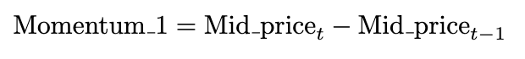
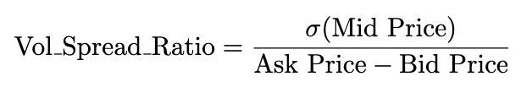
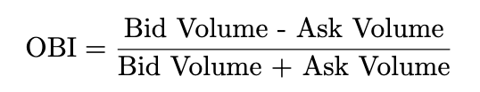
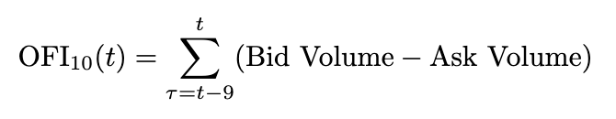
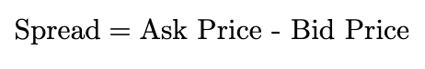
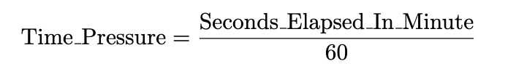
Variables
Momentum Factors: Capture mid-price changes over different short-term horizons (every 5-10 updates)
Volatility-to-Spread Ratio: Evaluates short-term price volatility relative to the market spread
Order Book Imbalance: Represents the direction of price movement based on bid and ask volume
Order Flow: Measures net aggressive trading at the best bid and ask prices over a time window of 10
Bid-Ask Spread: Represents the difference between the best ask price and the best bid price
Time Pressure: Represents the fraction of the current minute that has elapsed
Variable Construction

Slide 4
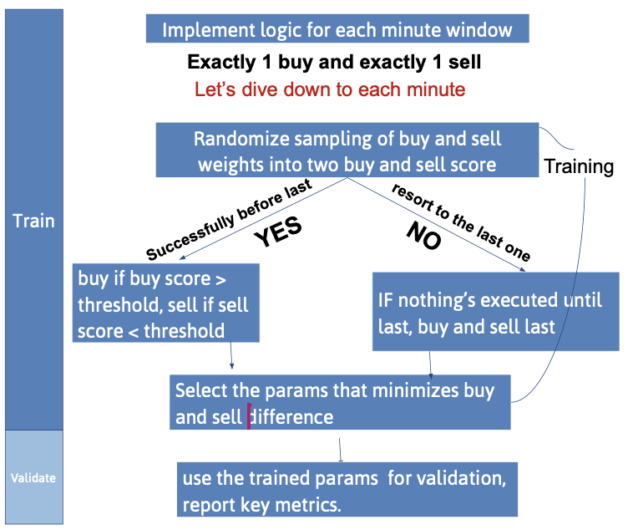
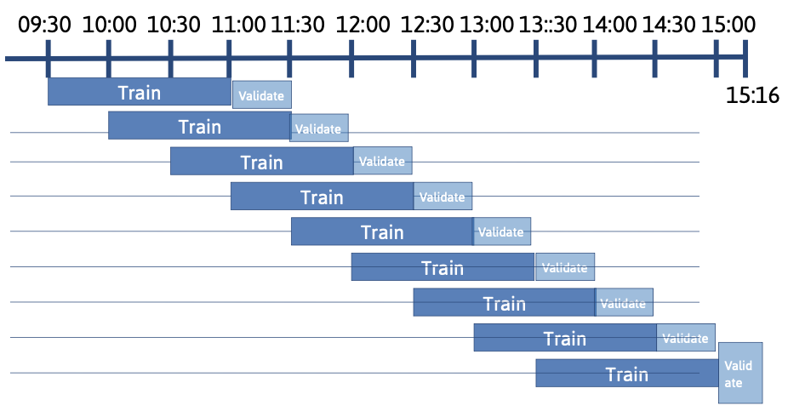
Strategic Logic - Pipeline
Factor Generation
Score Calculation
Trade Execution
Benchmark & Evaluation
Pipeline:
Approach:
Initial Approach: Before 12 VS After 12
Improved: Last 90 mins VS Next 30 mins
Backtest: Last 30 mins VS Next 5 mins
Algorithm Implementation

Slide 5
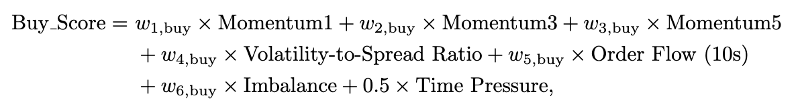
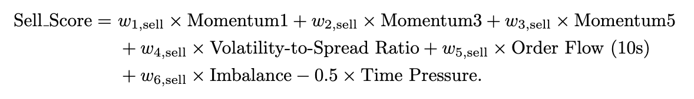
Strategic Logic - Score
Two independent scores
Separately trained; linear combination
Scoring threshold tuned to be (0,0) in milestone 2
buy if buy score > 0, sell if sell score < 0
If no trades meet scoring thresholds, executes last trade each minute
Algorithm Implementation

Slide 6
Refinements and Optimization
Rolling Window Design
Change: Overlapping rolling windows for train/validate segmentation —— Forward-looking while frequently re-tune on recent data.
Result: More robust performance, can’t keep all past information
Signal Weight Optimization
Change: The weight optimized over 500 sampled parameter sets —— better signal strength
Result: Higher score relevance, tighter buy-sell execution spreads
End-of-Minute Fallback Execution
Change: Trade the last order of minute if no thresholds met —— Guaranteed execution and position flattening per minute
Result: Reduced variance in returns
Algorithm Implementation

Slide 7
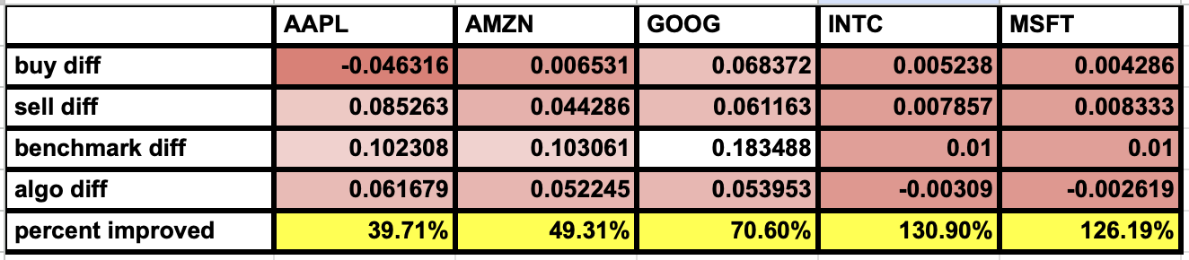
Performance Table From Backtest
Best Real Performers
GOOG: benchmark difference (0.18) reduced to (0.05) => 70% improvement
AAPL and AMZN had solid absolute improvement with better buy/sell differences
INTC and MSFT produced extremely high improvement percentages due to low benchmark baseline (around 0.01)
Requires further tuning as model may be overreacting to weak signals
Results & Visualizations

Slide 8
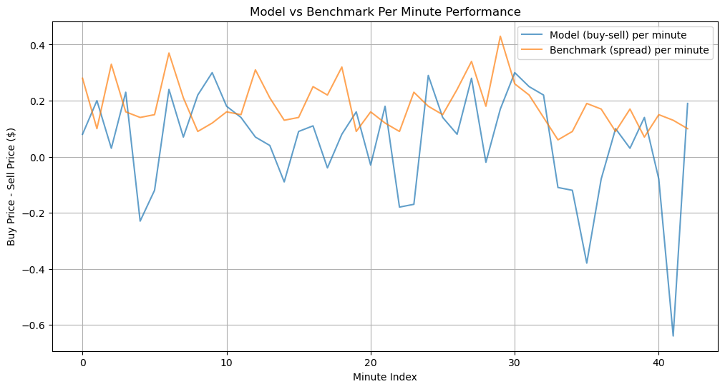
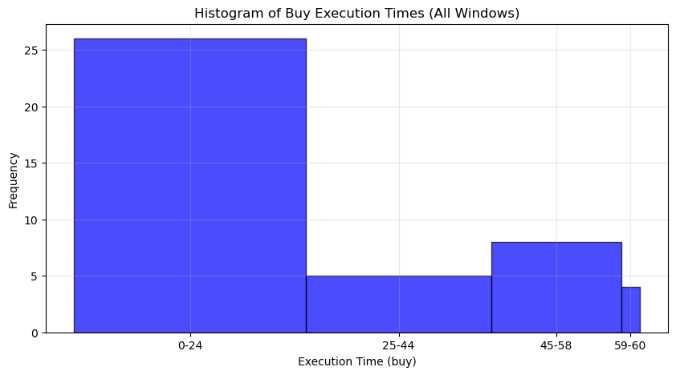
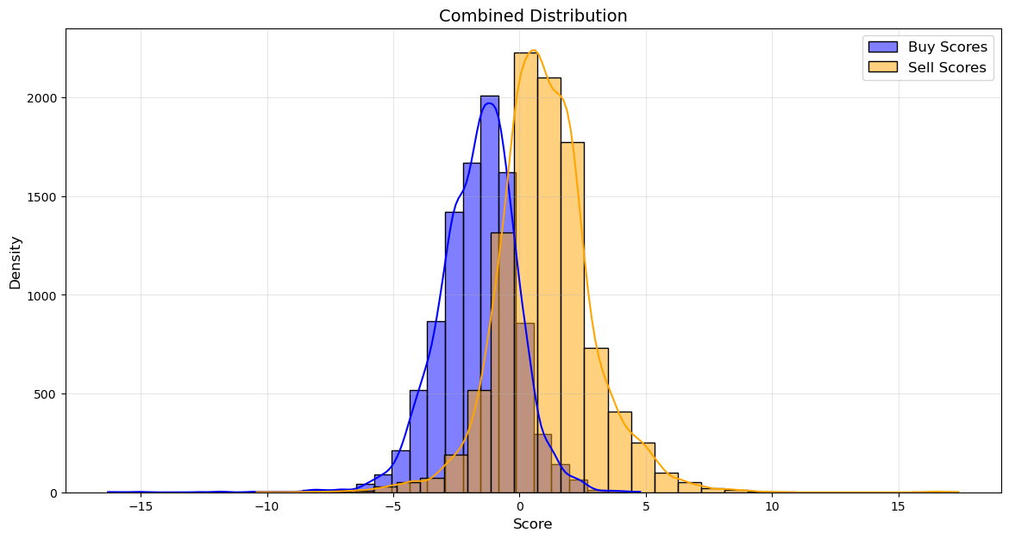
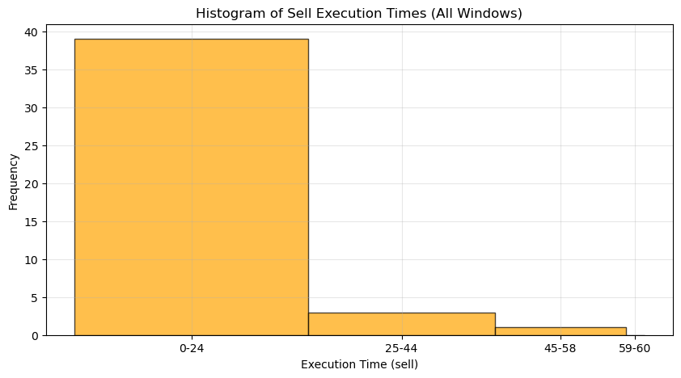
Visualizations in example of GOOG
Model vs Benchmark per minute performance
Execution Time Histograms
Distribution of Buy and Sell Score
Results & Visualizations

Slide 9
Critical Evaluation
😮 What Surprised Us
End-of-minute trades better than expected: reduced variance and ensured continuity.
Score sensitivity: Minor changes in weights matters!
🧪 What We’d Try Next
Smarter parameter search: Smarter methods for weight and threshold tuning.
Dynamic thresholds: Learn threshold values for volatility or market regime.
Analysis

Slide 10
Conclusion
📈 Summary
Huge buy-sell spread improvement over the TWAP benchmark!
Adapts to momentum, volatility, imbalance, and order flow, and executed trades early
✅ Key Takeaways
Adaptive scoring improves microstructure execution with rolling validation.
Fallback logic ensures stability and realism under weak signals.
Rolling windows align the model with live strategy needs, reducing overfitting.
Analysis

